Slide 1
Deep Learning Based Motor Control Unit
Made BY:
Abhinav rai (13-BCS-0005)
ASHHAR HASAN (13-BCS-0015)

Slide 2
INTRODUCTION
Movement comes naturally to most of us. We run. We ride bikes. We walk to work.
But diseases that our affect muscles and bones make these simple motions not so simple.
We are using OpenSim to create highly accurate models of humans and how they move.
Development of physics-based locomotion controllers using reinforcement learning and independent from captured motion data.
Generation of generic locomotion controllers for large number of tasks such as standing, walking, crouching and gait.

Slide 3
Applications
Yield insights into the design of assistive devices to reduce the metabolic cost of running and increase performance.
Modelling the effects of regenerative surgery.
Using OpenSim to simulate humanoid robots that can more closely match human motions.

Slide 4
OpenSim
OpenSim is a powerful, freely available software for simulating human movement.
Using the open-source OpenSim software platform human subjects can be examined to predict the changes in muscle recruitment patterns and metabolic power consumption with assistive devices.
OpenSim is used in movement science and focus on critical areas of rehabilitation medicine, including stroke, spinal cord injury, cerebral palsy, prosthetics, orthotics, and osteoarthritis.

Slide 5
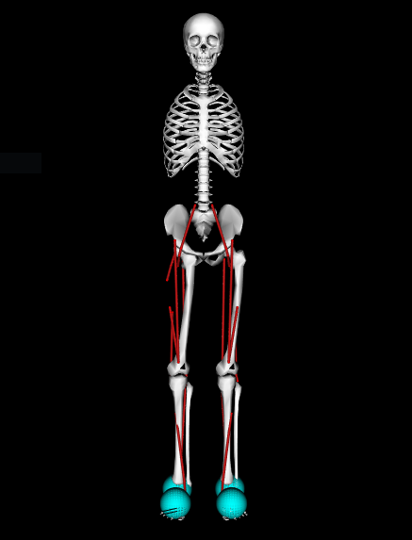
Example Models
For our project we used a musculoskeletal model HUMAN with 18 muscles and 9 degrees of freedom.
The joints in the model are namely:
Pelvis
Hip (Left and right)
Knee (Left and right)
Ankle (Left and right)
Subtalar (Left and right)
Metatarpal (Left and right)
Back
Notes:
Bayesian Classification – Baye’s theorem based on prior probability
Noisy Channnel Algorithm – We treat the errors as errors introduced during transmission according to Shannon’s theorem and then try and use information theory to correct those errors.

Slide 6
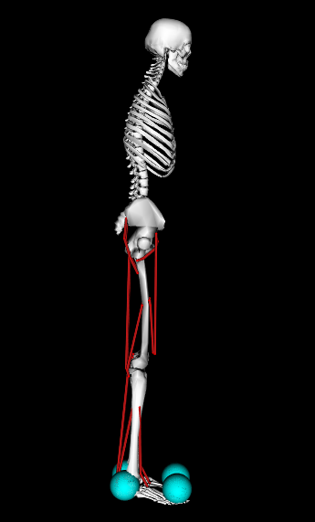
Example Models
The muscles in the model are namely:
Hamstrings (Left and right)
Bifemsh (Left and right)
Glut (Left and right)
Iliopsoas (Left and right)
Rectus Femoris (Left and right)
Vasti (Left and right)
Gastrocnemius (Left and right)
Soleus (Left and right)
Tibialis anterior (Left and right)
Notes:
Bayesian Classification – Baye’s theorem based on prior probability
Noisy Channnel Algorithm – We treat the errors as errors introduced during transmission according to Shannon’s theorem and then try and use information theory to correct those errors.

Slide 7
Previous Approaches
SIMBICON is a robust 3D humanoid locomotion controller based on balance control.
It used a simple finite-state machine or pose control graph and the joints were controlled by proportional derivative (PD) controllers.
Efforts have been made to make the synthesized motions more human-like and natural.

Slide 8
Shortcomings of Previous Approaches
SIMBICON-style controllers tend to produce gaits lacking hip extension with a constant foot orientation.
Knee angles lack flexion during swing, but lack extension at heel strike.
Controllers relying on hand-tuned trajectories cannot be easily used to investigate how the control strategies change with respect to new constraints.
Reinforcement learning instead of expensive and complex explicit programming robots can teach robots how to move in virtual spaces.

Slide 9
Proposed Algorithm
Creation of biomechanical models for modelling human standing, crouching, walking and gait using Stanford OpenSim.
Creation of an environment to train and test the models for the four scenarios.
Using reinforcement learning to learn a control policy for motion that increases the stability of the model.

Slide 10
Parameters For Reward Function
Position of pelvis
Position of head
Positions of left foot and right foot
Position of all 13 joints in the model
Length of all 18 muscles in the model
Position of center of mass
Velocity of center of mass
Acceleration of center of mass

Slide 11
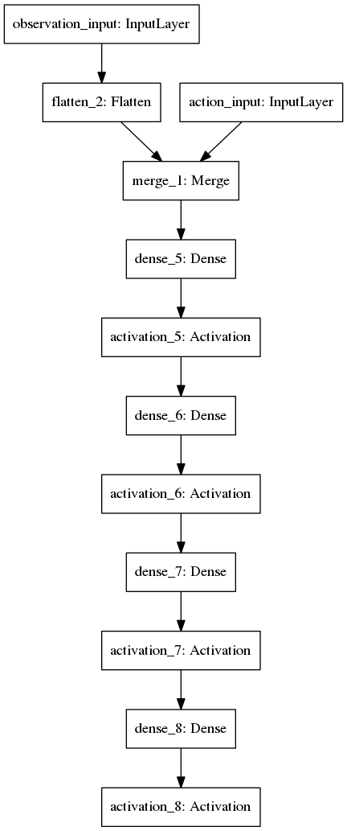

Neural Network Design
A simple neural network could use the following architecture:
Input layer.
3 layers of fully connected 32 units with rectifier activation.
$$f\left(x\right)=\max\left(0,x\right)≡ln⁡(1+e^{x})$$
1 layer of fully connected n units where n is the size of our action space with a sigmoid activation.
$$f\left(x\right)=\frac{1}{1+e^{−t}}$$

Slide 12
Proposed Algorithm
Deep Q Learning (DQN)
Double DQN
Deep Deterministic Policy Gradient (DDPG)
Continuous DQN (CDQN or NAF)

Slide 13

Double DQN
Q-learning is one of the most popular reinforcement learning algorithms, but it is known to sometimes learn unrealistically high action values because it includes a maximization step over estimated action values, which tends to prefer overestimated values.
Deep Q-network (DQN), combines reinforcement learning with a class of artificial neural network known as deep neural networks.
The max operator in standard Q-learning and DQN uses the same values both to select and to evaluate an action. This makes it more likely to select overestimated values, resulting in overoptimistic value estimates. To prevent this, we can decouple the selection from the evaluation. This is the idea behind Double Q-learning.
$$V_{i+1}^{π}(s)←\sum_{s^{′}}{T\left(s,π\left(s\right),s^{′}\right)[R\left(s,π\left(s\right),s^{′}\right)+γV_{i}^{π}}(s^{′})]$$
Bellman Equation

Slide 14


Deep Deterministic Policy Gradient (DDPG)
DDPG is a model-free algorithm based on the deterministic policy gradient that can operate over continuous action spaces.
In DQN the number of actions increases exponentially with the number of degrees of freedom. For example, a 7 degree of freedom system (as in the human arm) with the coarsest discretization $a_{i}∈\{−k,0,k\}$ for each joint leads to an action space with dimensionality : $3^{7}=2187$.
The DPG algorithm maintains a parameterized actor function $μ(s|θ^{μ})$ which specifies the current policy by deterministically mapping states to a specific action. The critic Q(s, a) is learned using the Bellman equation as in Q-learning. The actor is updated by following the applying the chain rule to the expected return from the start distribution J with respect to the actor parameters:

Slide 15


Continuous DQN (CDQN or NAF)
It is a continuous variant of the Q-learning algorithm, which we call normalized advantage functions (NAF), as an alternative to the more commonly used policy gradient and actor-critic methods.
The Q-function is represented as a neural network that separately outputs a value function term V(x) and an advantage term A(x,u), which is parameterized as a quadratic function of nonlinear features of the state:
$P(x|θ^{P}) = L\left(x | θ^{P}\right)L{\left(x | θ^{P}\right)}^{T}$ , where $L\left(x | θ^{P}\right)$is a lower-triangular matrix whose entries come from a linear output layer of a neural network, with the diagonal terms exponentiated.

Slide 16
Programming Environment and Tools Used
Python
TensorFlow
Keras-RL
Stanford OpenSim
Stanford Simbody
NumPy
SciPy
Scikit-Learn

Slide 17
References
Deep learning based motor control unit - Viktor Makoviichuk, Peter Lapko (2016)
Flexible Muscle-Based Locomotion for Bipedal Creatures - Thomas Geijtenbeek, Michiel van de Panne, A. Frank van der Stappen (2013)
Learning and Transfer of Modulated Locomotor Controllers - Nicolas Heess, Greg Wayne, Yuval Tassa, Timothy Lillicrap, Martin Riedmiller, David Silver (2016)
Locomotion Skills for Simulated Quadrupeds - Stelian Coros, Andrej Karpathy, Ben Jones, Lionel Reveret, Michael van de Panne (2011)
Optimizing Locomotion Controllers Using Biologically-Based Actuators and Objectives - Jack M. Wang, Samuel R. Hamner, Scott L. Delp, Vladlen Koltun (2012)
Terrain-Adaptive Locomotion Skills - Xue Bin Peng, Glen Berseth, Michiel van de Panne (2016)

Slide 18
Thank You

